Slide 1


Gadd Kaam – SkillSwap Pakistan
FINAL YEAR PROJECTS SESSION 2025
FINAL PRESENTATION
PROJECT ID: 2022-SWE-14
PROJECT DEVELOPER:
Farmanullah Ansari (2k22/SWE/40)
SUPERVISOR AND CO-SUPERVISOR
Dr. Rahat Ali Khan, Mohsin Jokhio
DEPARTMENT OF SOFTWARE ENGINEERING,
FACULTY OF ENGINEERING AND TECHNOLOGY
UNIVERSITY OF SINDH, JAMSHORO

Slide 2
Contents
Introduction of Project
Aims and Objectives
Scope of Project
Tools and Technologies
Development Methodology
System diagrams
System prototype / implementations screenshots
Conclusion and Future Work

Slide 3
Introduction of Project
Gadd Kaam is a web-based skill exchange platform designed for rural and underserved communities in Pakistan.
Instead of relying on money, users can swap skills—for example, tailoring in exchange for tutoring, or web development in exchange for tractor repair.
The platform supports:
Multilingual access (Sindhi, Urdu, and English).
Safe zones for women to exchange skills in a protected environment.
By removing barriers such as English literacy, digital payments, and urban focus, Gadd Kaam provides inclusive access to economic and social opportunities in Pakistan’s rural regions.

Slide 4
Aims and Objectives
Aim
To build a trusted, inclusive, and multilingual skill-exchange platform that enables rural communities in Pakistan to share and swap skills without money.
Objectives
Multilingual Support – Build interfaces in Urdu & Sindhi with voice navigation for low-literate users.
Skill Exchange Mechanism – Develop a barter system where users exchange services instead of money.
Skill Verification – Partner with local leaders & NGOs to validate user skills with badges.
Gender-Specific Features – Safe zones and anonymous listings for women.

Slide 5
Scope of Project
Initially limited to University of Sindh students and surrounding rural communities, the platform will:
Focus on peer-to-peer skill swaps (web development, tailoring, electronics, agriculture, tutoring, etc.).
Be accessible in Sindhi, Urdu, and English.
Include skill verification, and safe spaces for women.
Designed to work smoothly on standard web browsers, ensuring easy access for users across devices.
👉 Future Expansion: Broader rural Pakistan with mobile app and integration with JazzCash/Easypaisa for optional financial services.

Slide 6
Tools and Technologies
Frontend: React.js + Vanilla CSS
Backend: Node.js + Express.js
Database: MongoDB
Other Tools: GitHub,Visual Studio Code

Slide 7
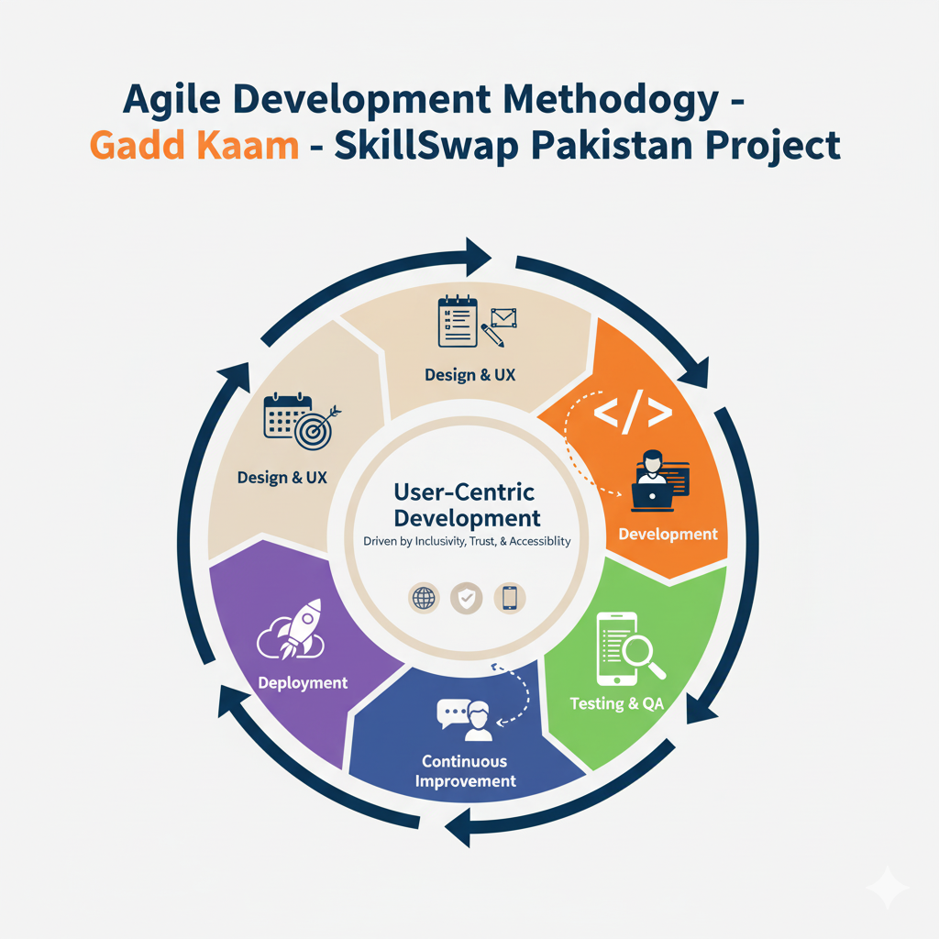
Development Methodology

Slide 8
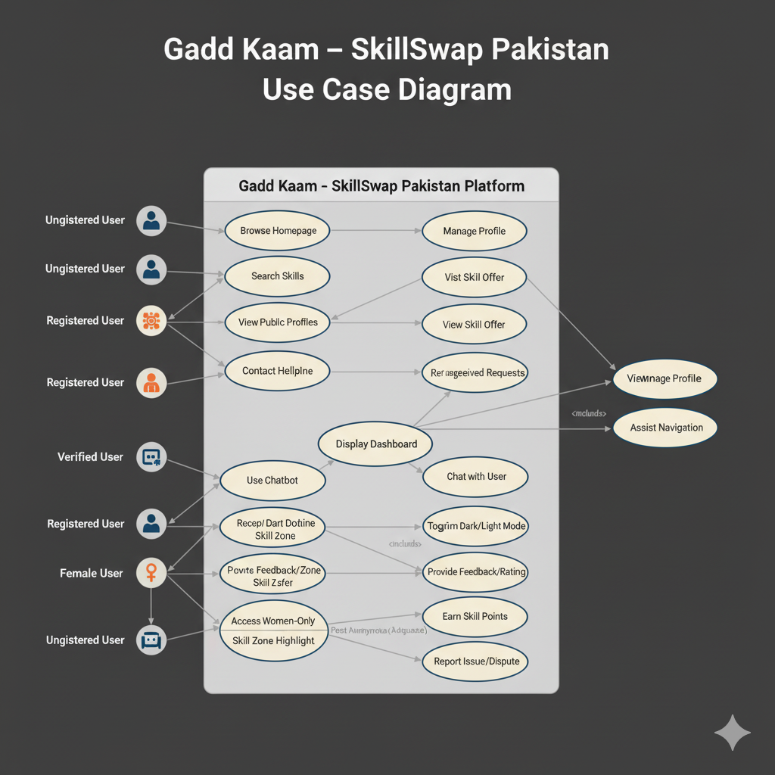
System diagrams

Slide 9
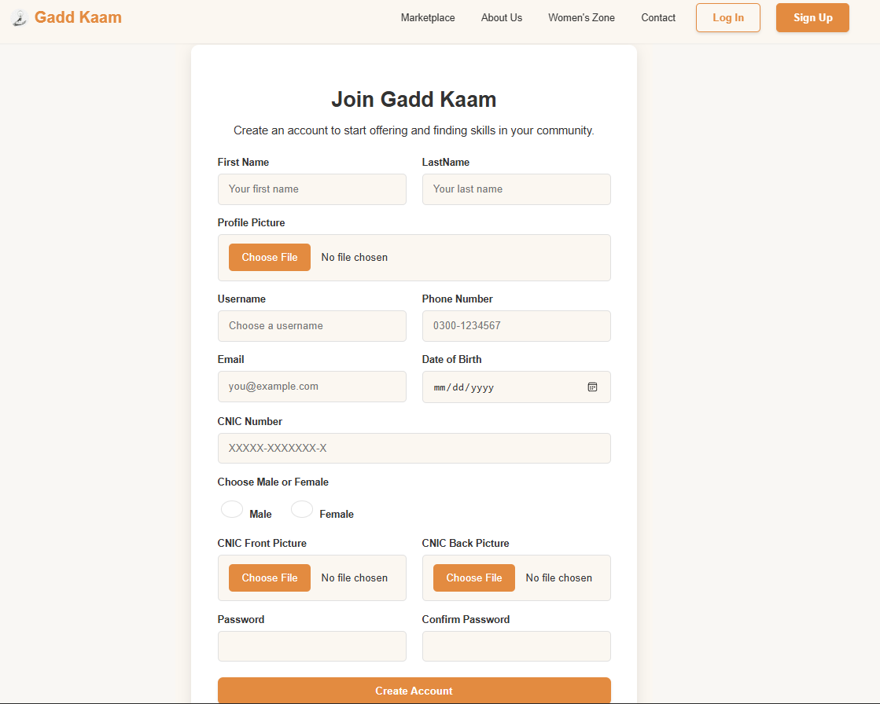
System Prototype : Signup Page

Slide 10
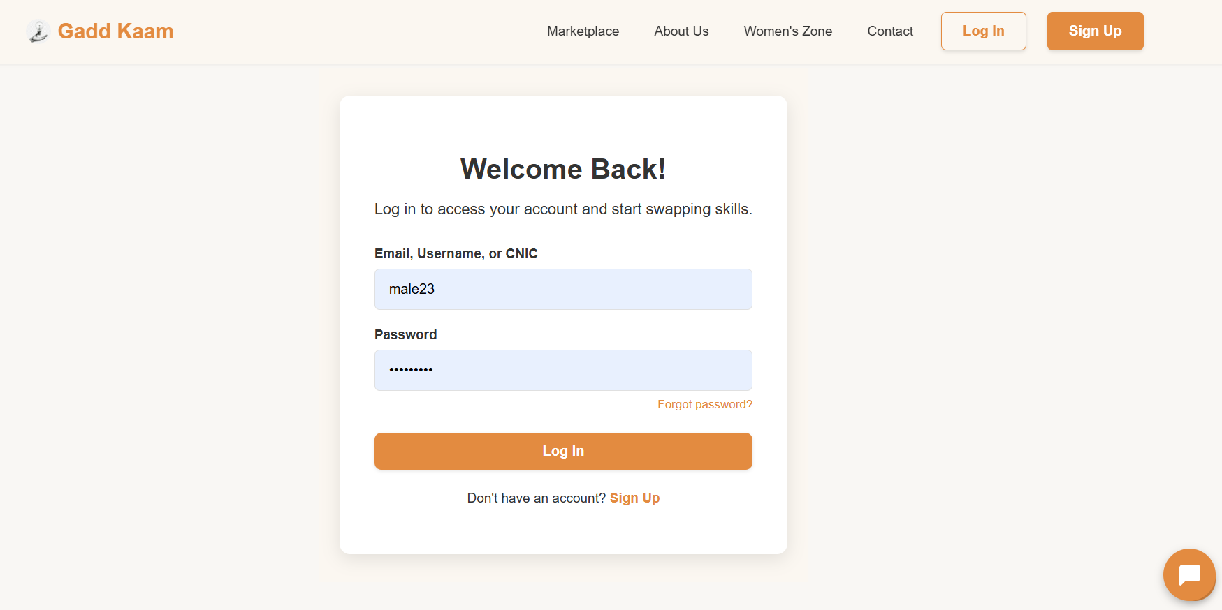
System Prototype : Login Page

Slide 11
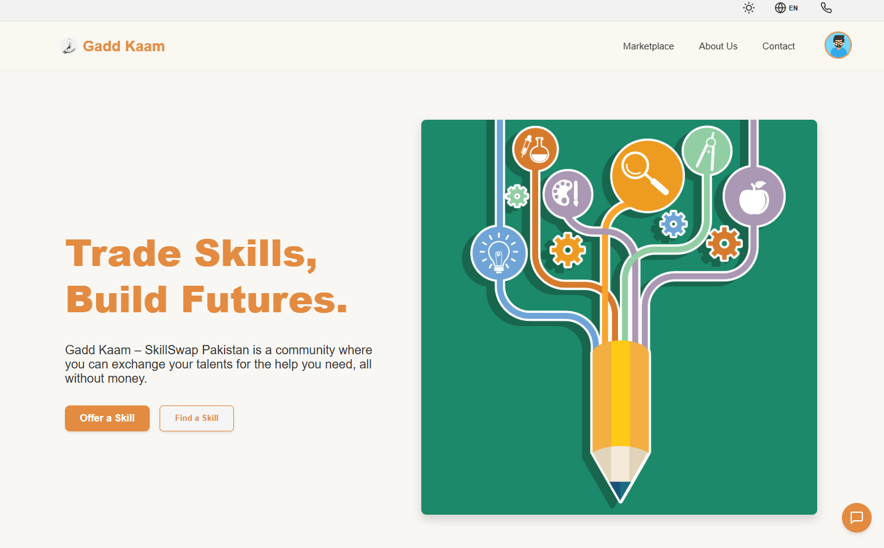
System Prototype : Home Page (Light)

Slide 12
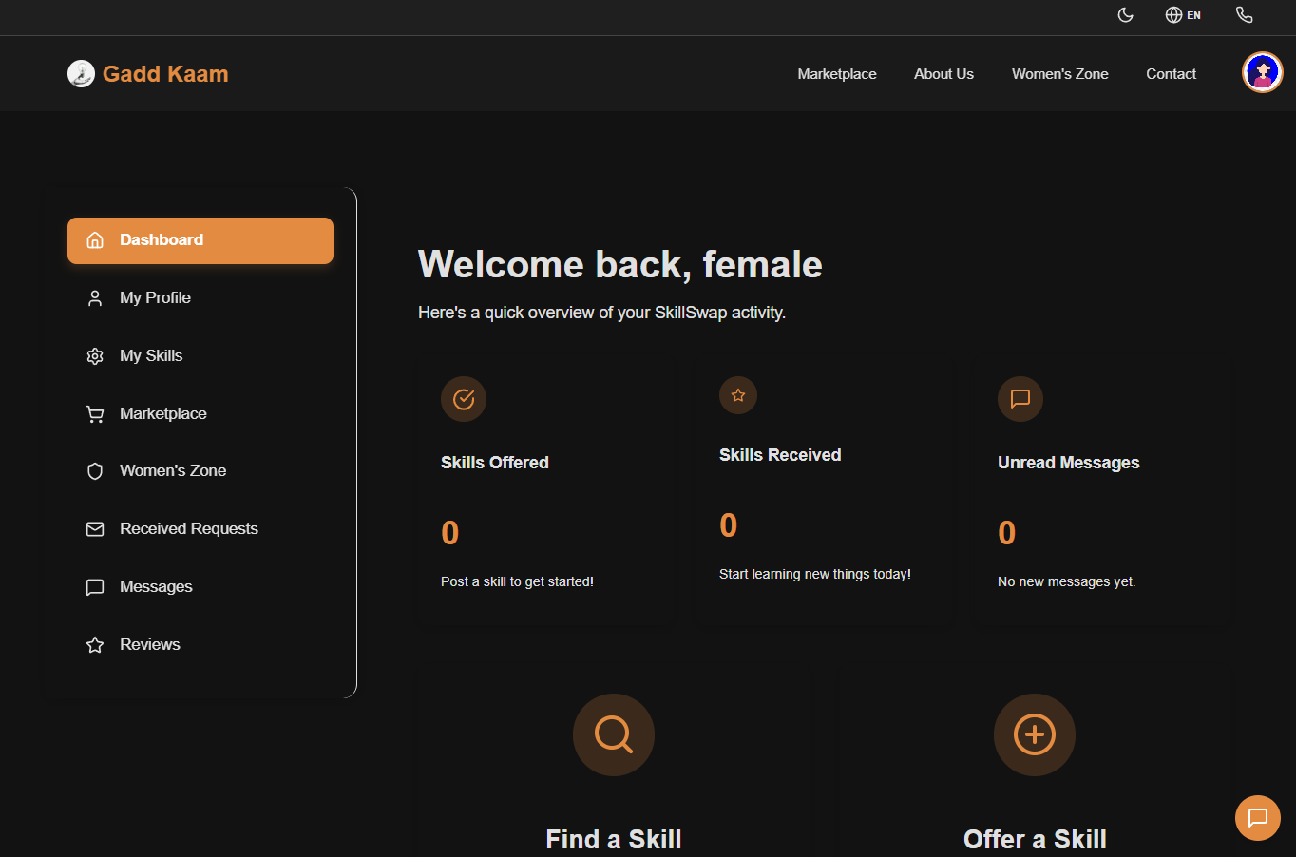
System Prototype : User Dashboard (Dark)

Slide 13
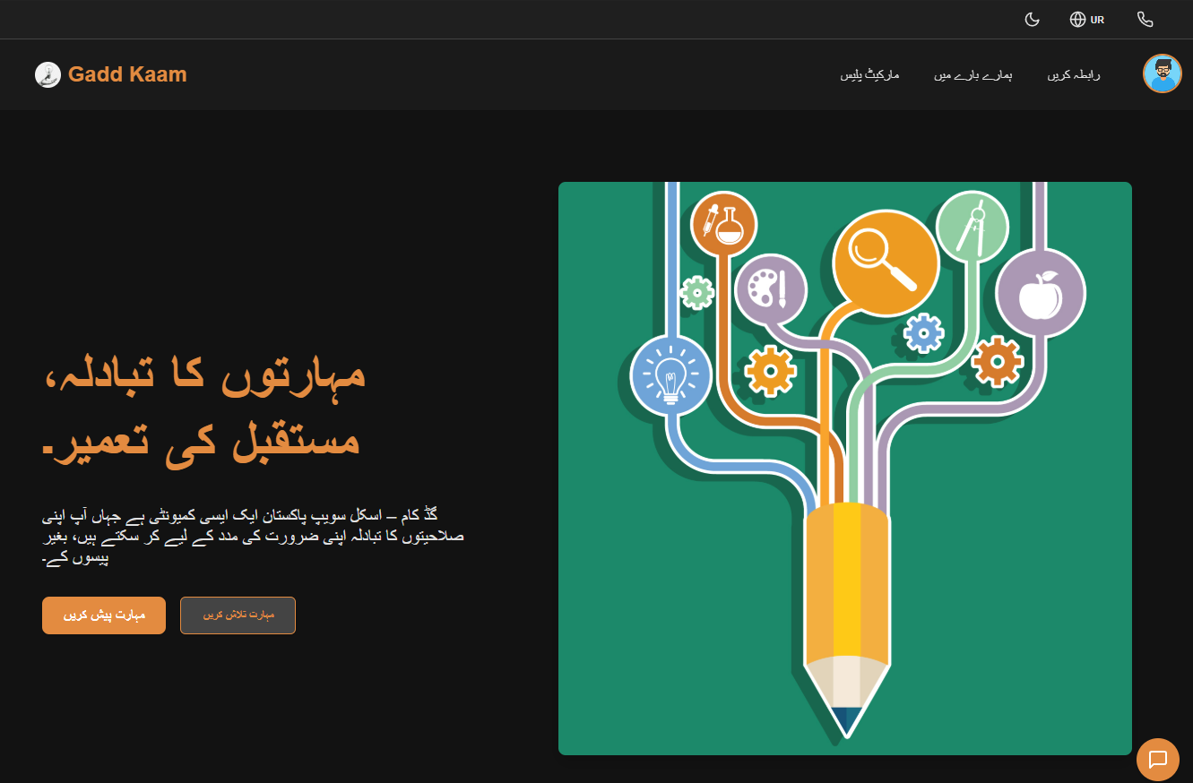
System Prototype : Home Page (Urdu)

Slide 14
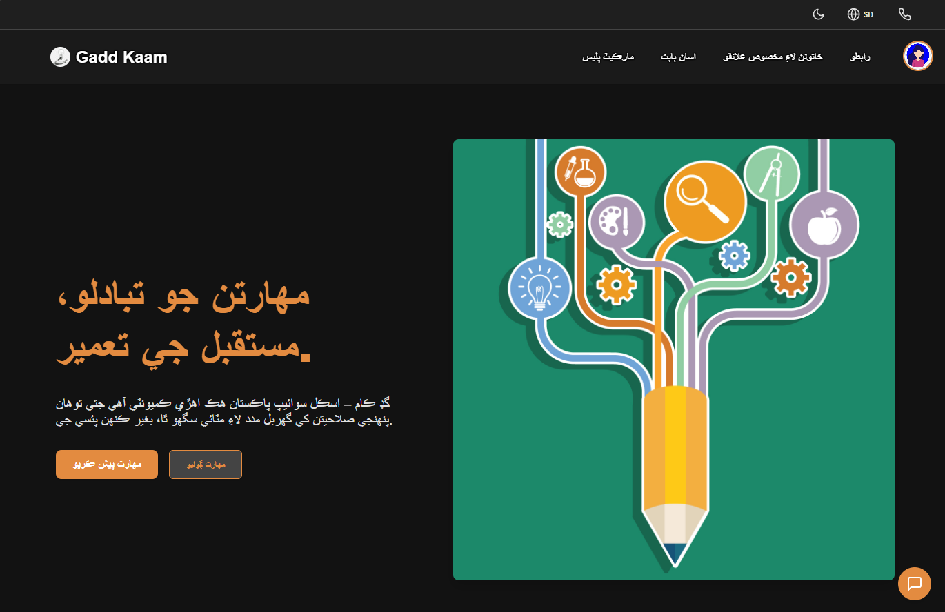
System Prototype : Home Page (Sindhi)

Slide 15
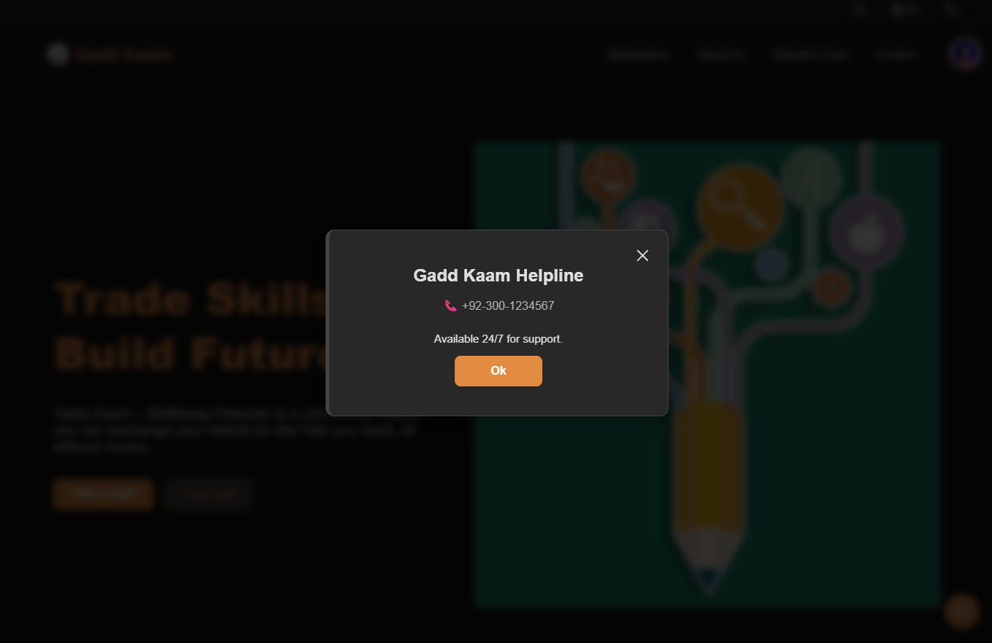
System Prototype : Home Page (helpline)

Slide 16
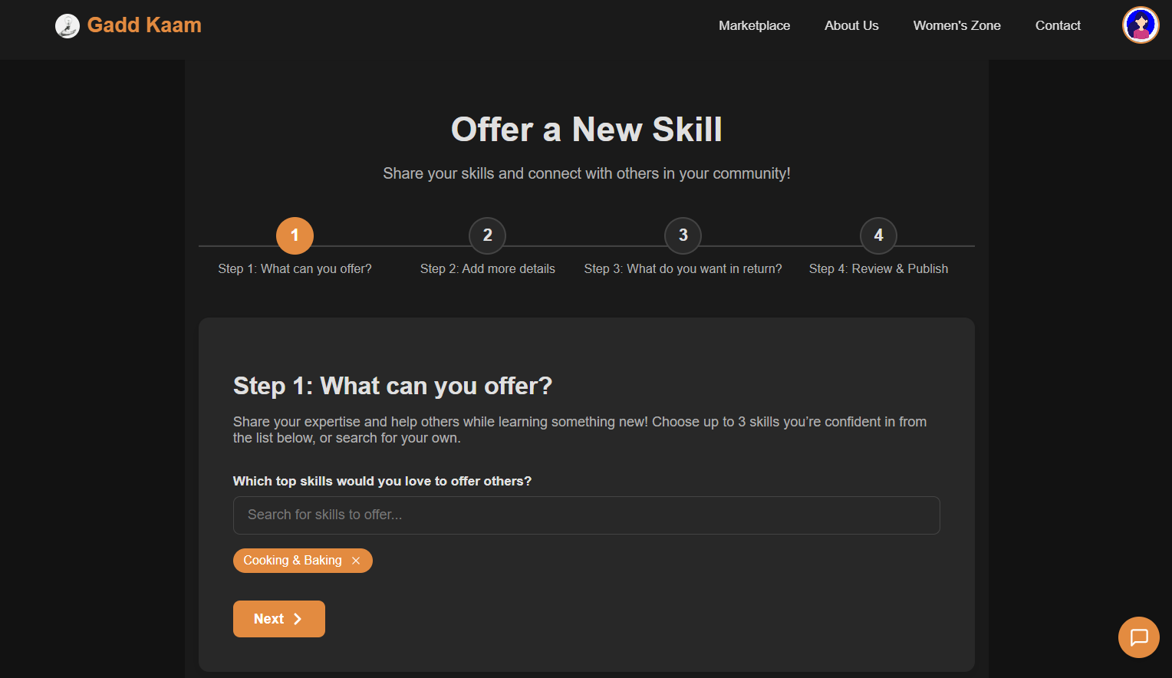
System Prototype : Offer Skill Page(Step 1)

Slide 17
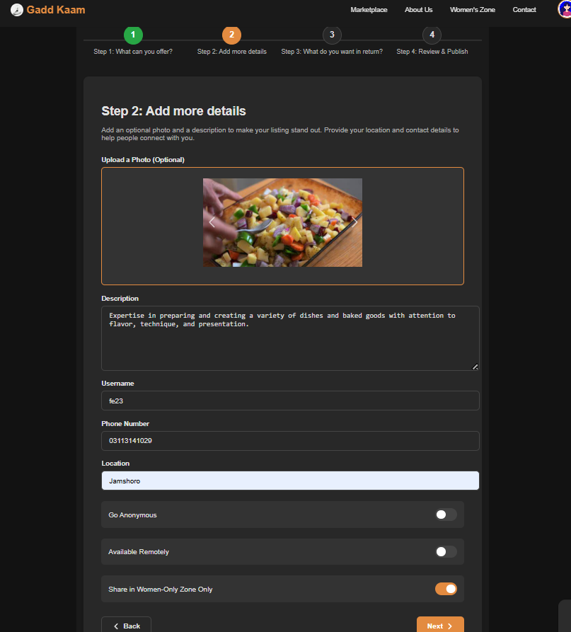
System Prototype : Offer Skill Page(Step 2)

Slide 18
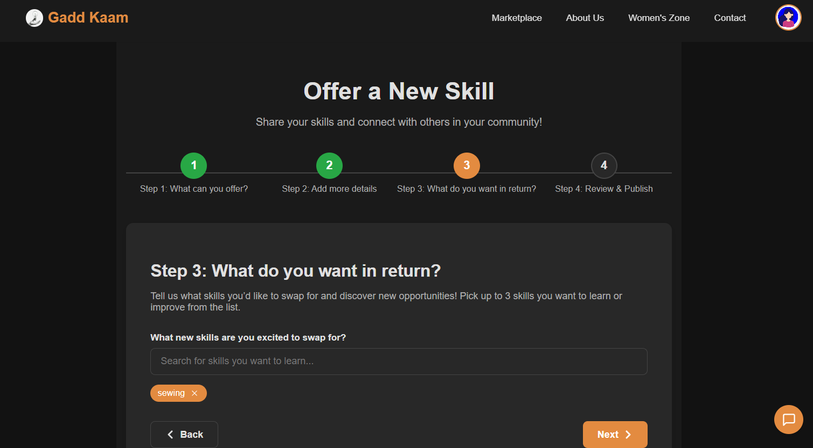
System Prototype : Offer Skill Page(Step 3)

Slide 19
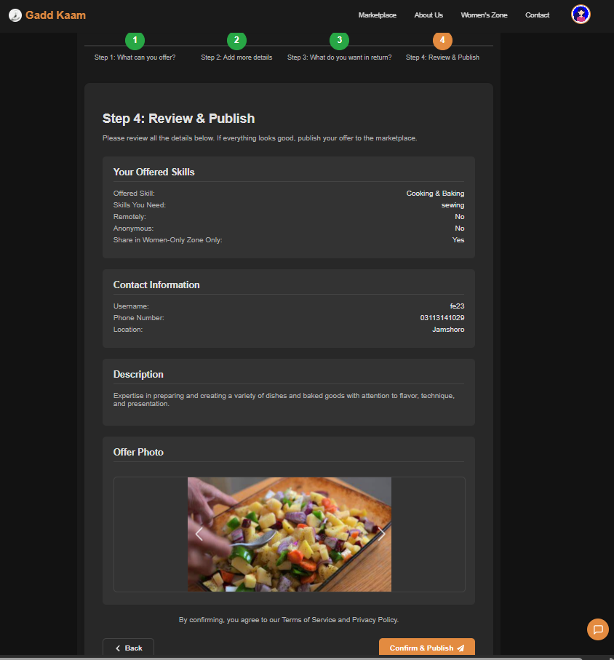
System Prototype : Offer Skill Page(Step 4)

Slide 20
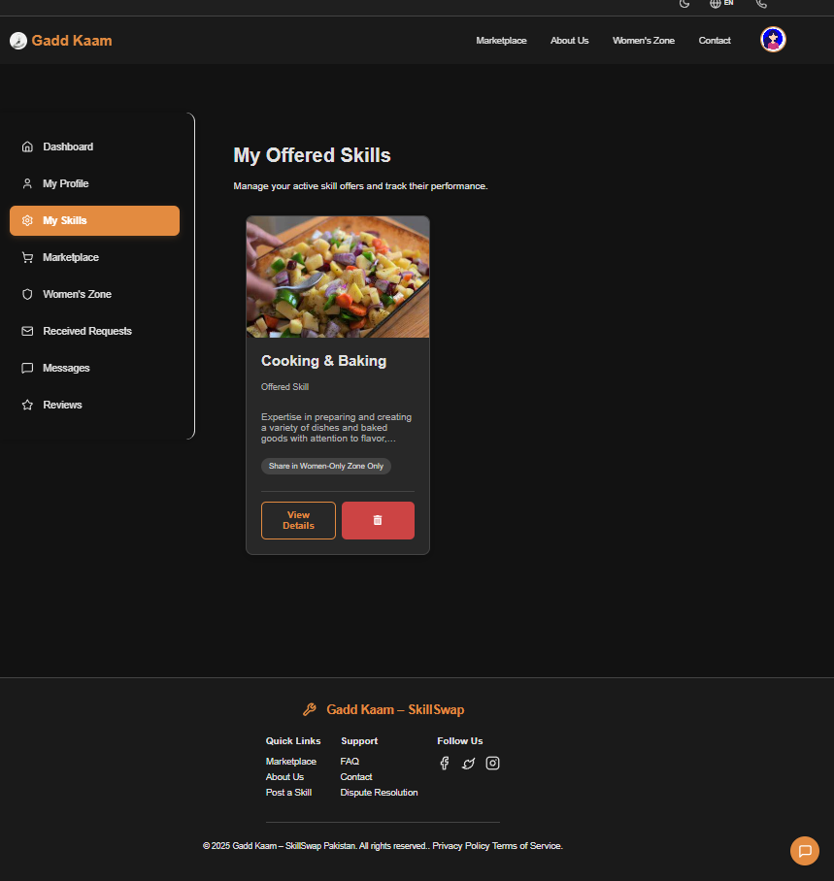
System Prototype : My Offered Skills Page

Slide 21
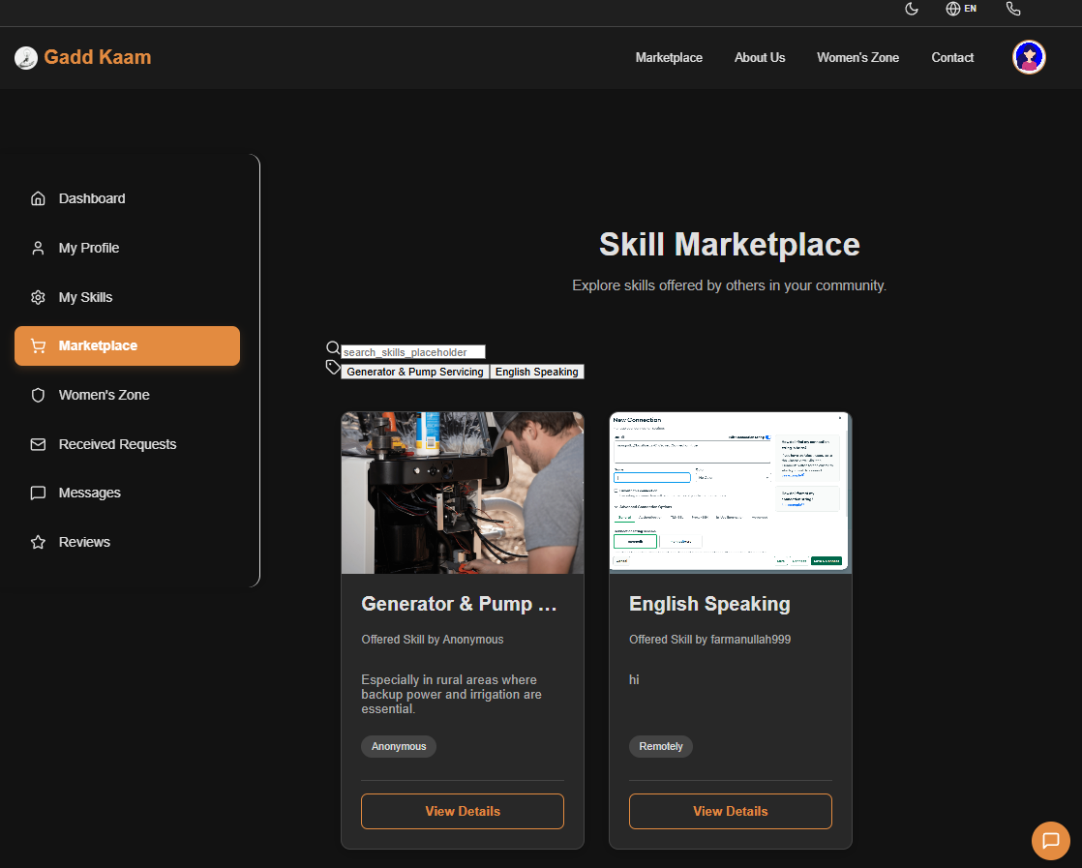
System Prototype : Skill Marketplace Page

Slide 22
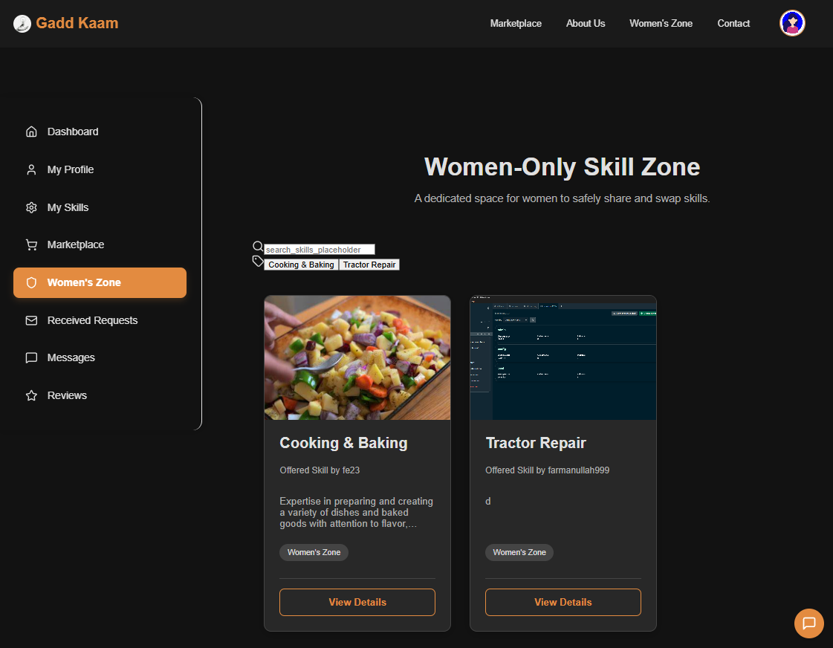
System Prototype : Women-Only Skill Zone Page

Slide 23
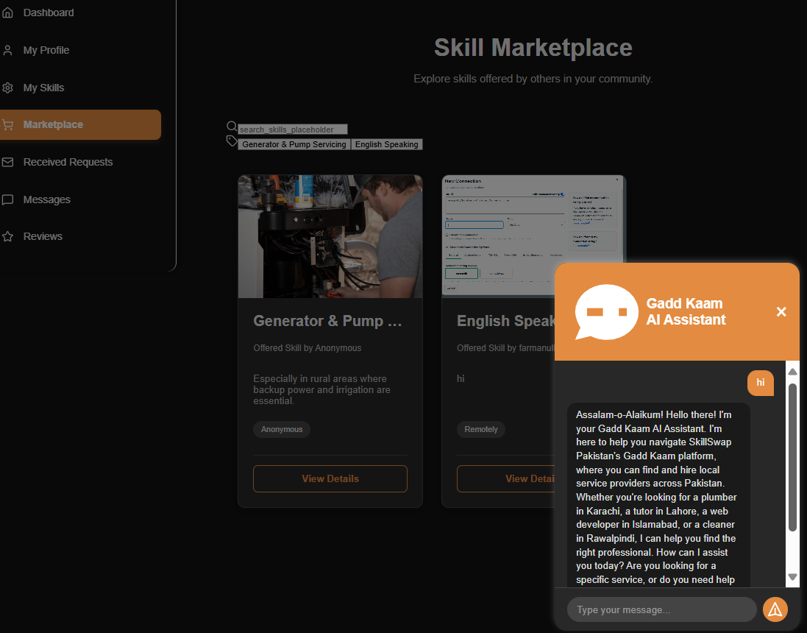
System Prototype : chatbot Section

Slide 24
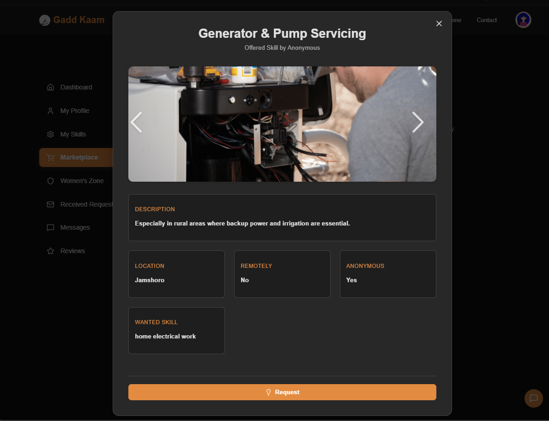
System Prototype : Skill Card and Request Button

Slide 25
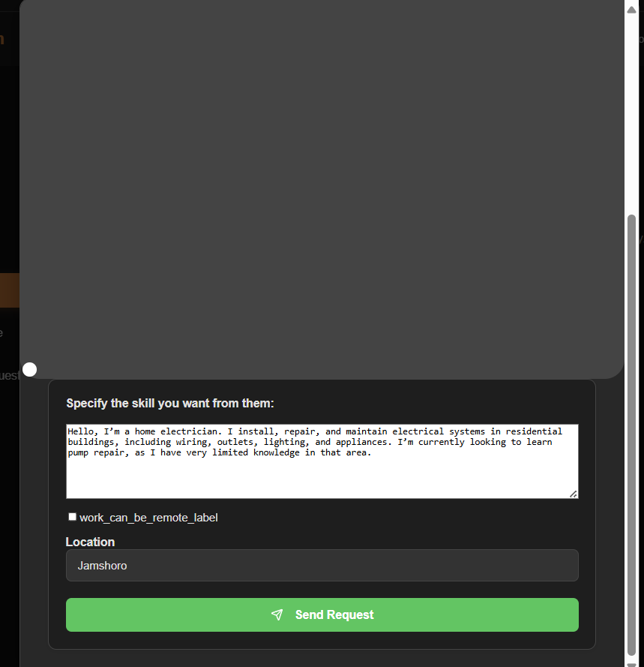
System Prototype : Request Button

Slide 26
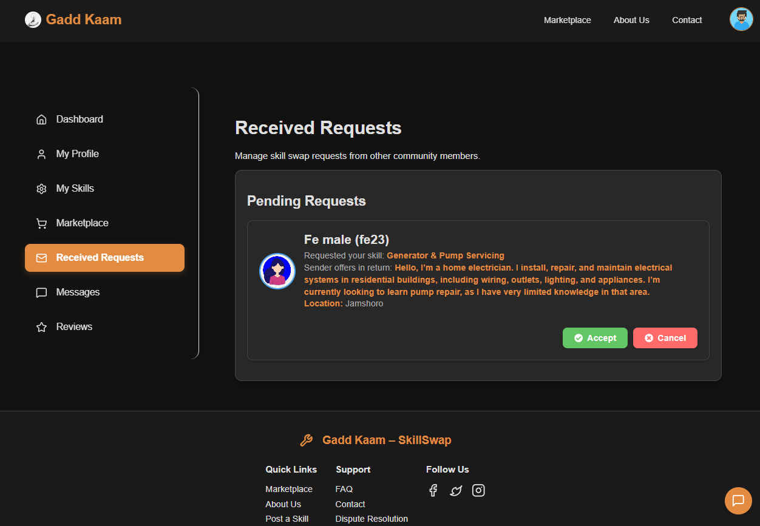
System Prototype : Request Received Section

Slide 27
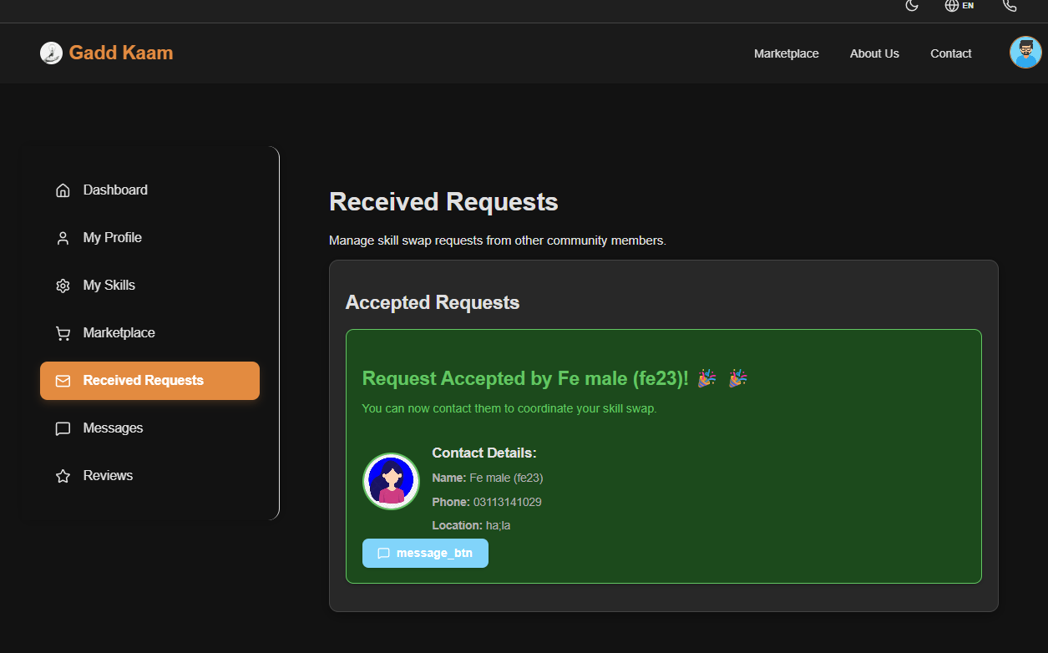
System Prototype : Request Received Section(After Accepting)

Slide 28
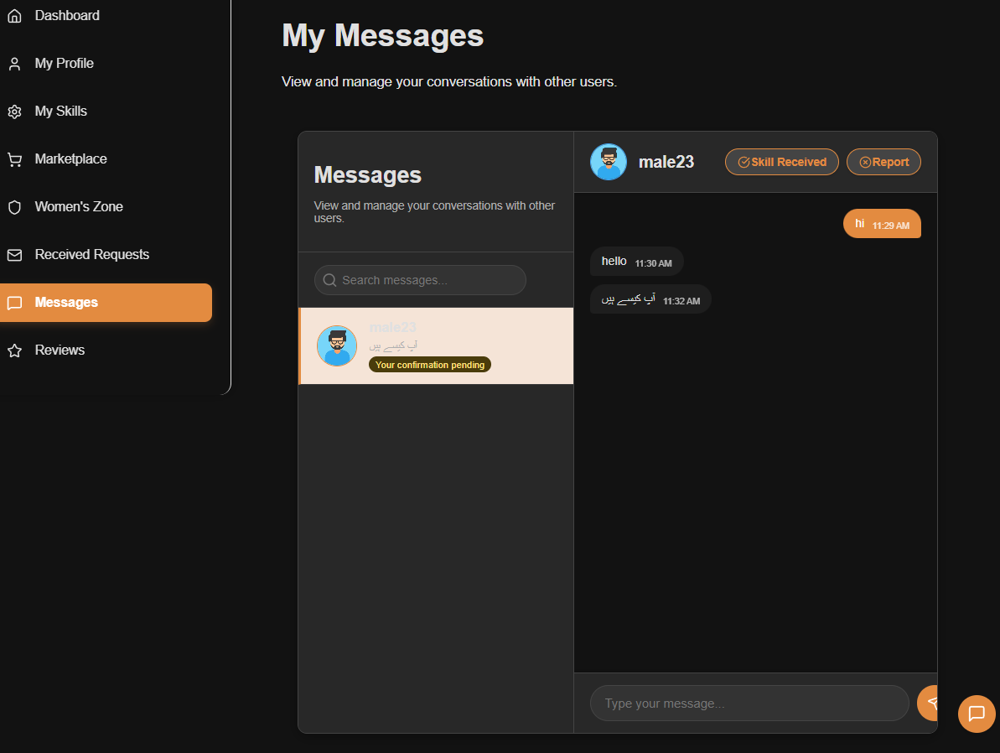
System Prototype :Messages Section(After Accepting)

Slide 29
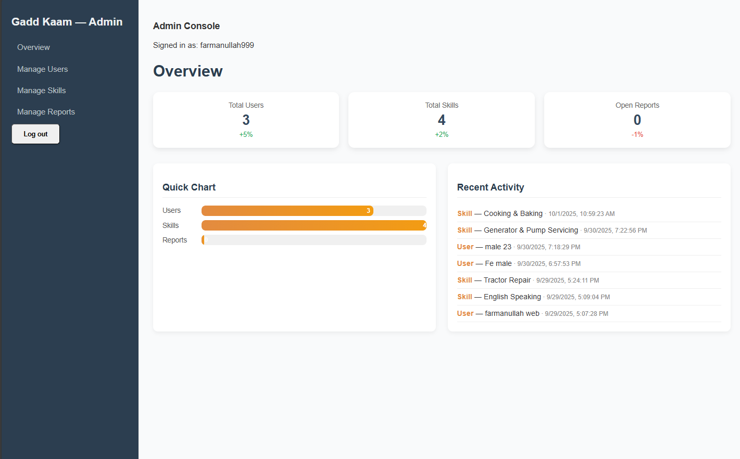
System Prototype : Admin Deshboard

Slide 30
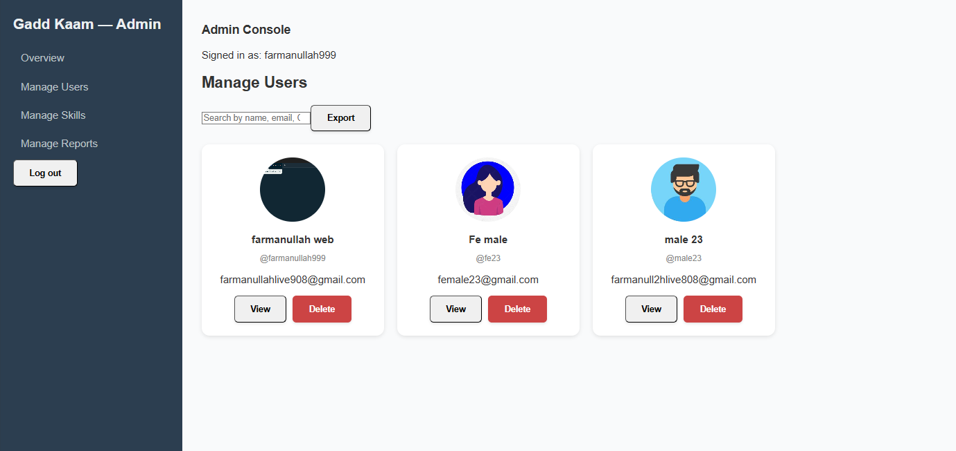
System Prototype : Admin Deshboard (Manage Users)

Slide 31
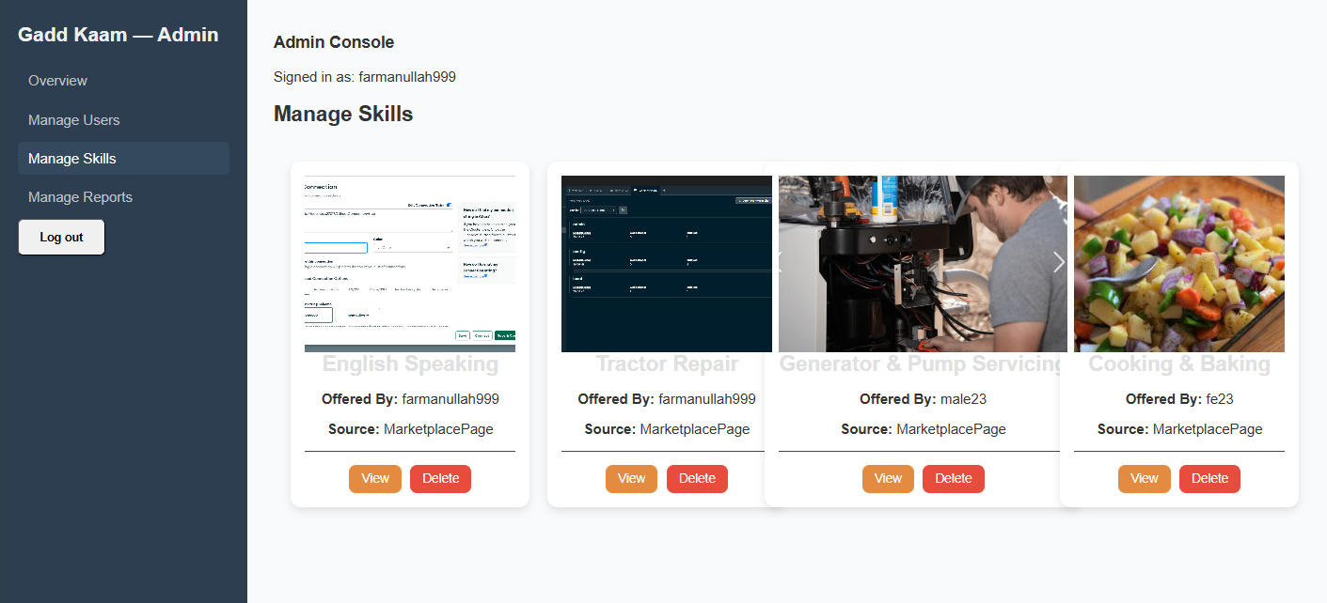
System Prototype : Admin Deshboard (Manage Skills)

Slide 32
Future Work
📝 Review & Report Sections
Develop dedicated modules for user reviews and detailed activity reports to enhance transparency and feedback.
🏅 Skill Badge System
Introduce visual skill badges based on verified contributions, peer endorsements, and completed exchanges.
🎨 Design Enhancements
Refine UI/UX across the platform to improve accessibility, visual appeal, and user engagement.
📊 User Dashboard Improvements
Enhance dashboard functionality with personalized insights, skill tracking, and exchange history.

Slide 33
Future Work
👤 User Profile Refinement
Upgrade profile features to include , verification status, and customizable privacy settings.
💬 Message Interface Redesign
Improve the messaging system with threaded conversations, media sharing.
🤖 Chatbot Functionality
Expand chatbot capabilities to assist with skill discovery, FAQs, and onboarding support.
🛠️ Admin Dashboard & Report Management
Strengthen admin tools for managing users, moderating content, and handling community reports efficiently.

Slide 34
Project Contribution
Developer: Farmanullah Ansari (2k22/SWE/40):

